Slide 1

Marketing Attribution CFDS Team Meeting 31-July-2017
Notes:
A title slide can be custom. It means only designer can create it.

Slide 2
Problem Statement

Slide 3

“Companies spend a lot on marketing communications. In fact, global spending on media is expected to reach $2.1 trillion in 2019, up from $1.6 trillion in 2014. But is all that money well spent? And more fundamentally, does marketing actually work?”
Source: https://hbr.org/2017/07/a-refresher-on-marketing-roi?utm_campaign=hbr&utm_source=twitter&utm_medium=social
Notes:
You can find a relevant icon in our icons kit.

Slide 4
Varying Touch Points for Each Customer
Customer A
Email
Bank
Customer B
SMS
Google Ad
Customer A
Email
Google Ad

Slide 5

What Was the Contribution of Each Touch Point?
Email
SMS
Google Ad

Slide 6
Solution

Slide 7


Keep History of Touch Points and Purchasing Behaviour
Email
SMS
Google Ad
Customer A
Customer B
Customer C

Slide 8

But I Don’t Know Which Customers Saw My Google Ads and Who Saw My TV Ads!
Notes:
You can find a relevant icon in our icons kit.

Slide 9

Best Practice: Use A/B Testing. Exclude control groups from your direct contact marketing. Have control time periods where you don’t run Google ads, Facebook ads, TV ads etc.
Notes:
You can find a relevant icon in our icons kit.

Slide 10
If you have time periods when you didn’t run ads, then even without direct attribution, DataRobot can infer how the ads increase sales, and the type of people who responded best to your ads.
Notes:
You can find a relevant icon in our icons kit.

Slide 11

Build a Propensity Model Using DataRobot
Email
SMS
Google Ad
Customer A
0.23
Customer B
0.04
Customer C
0.15
Direct: We know who received emails and SMSs
Indirect: We know when we ran Google Ads and when customers purchased.

Slide 12
Start With the Baseline Scenario – No Marketing Actions
Email
SMS
Google Ad
Lift
Customer A
0.11
0.12
Customer B
0.01
0.03
Customer C
0.09
0.06
What-If: Propensity without any marketing actions
Increase in propensity when marketing touch points were used i.e. benefit of marketing actions

Slide 13

Customer A Is Easy: There’s Only One Marketing Touch Point
Notes:
You can find a relevant icon in our icons kit.

Slide 14
Customer A: We Know That Email Caused The Lift
Email
SMS
Google Ad
Lift
Customer A
0.12

Slide 15
Customer C Is Easy: They Did Not Purchase, So No Contribution
Notes:
You can find a relevant icon in our icons kit.

Slide 16
Customer C: Did Not Purchase, So Zero Attribution
Email
SMS
Google Ad
Lift
Customer C
0.06

Slide 17
Problem: Customer B has multiple marketing touch points. What was the contribution split for each touch point?
Notes:
You can find a relevant icon in our icons kit.

Slide 18
Customer B: Email and Bank Together Caused Lift
Email
SMS
Google Ad
Lift
Customer B
0.03

Slide 19
We want to know the marketing lift from marketing actions. This involves comparing the propensities with and without the marketing.
Notes:
You can find a relevant icon in our icons kit.

Slide 20
Customer B: What If?
Email
SMS
Google Ad
Lift
Customer B
0.01
Customer B
0.035
0.025
Customer B
0.03
0.02
Customer B
0.04
0.03

Slide 21
Problem: The Individual Contribution of Each Marketing Campaign is NOT EQUAL To The Actual Total Result
Notes:
You can find a relevant icon in our icons kit.

Slide 22
Customer B: What If?
Email
SMS
Google Ad
Lift
Customer B
0.01
Customer B
0.035
0.025
0.025 + 0.02 is not equal to 0.03!
Customer B
0.03
0.02
Customer B
0.04
0.03

Slide 23
Solution: Calculate the Shapely Value
Notes:
You can find a relevant icon in our icons kit.

Slide 24
Shapely Value
Shapley value
The Shapley value is a solution concept in cooperative game theory. It was named in honour of Lloyd Shapley, who introduced it in 1953.^{[1][2]} To each cooperative game it assigns a unique distribution (among the players) of a total surplus generated by the coalition of all players. The Shapley value is characterized by a collection of desirable properties. Hart (1989) provides a survey of the subject.^{[3][4]}
An allocation technique derived from game theory and widely used by business managers and economists across many industries.

Slide 25
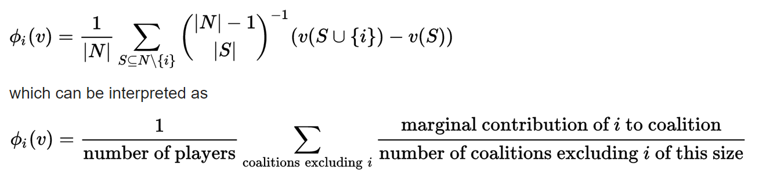
Shapely Value
This formula looks scary, but if you see a worked example then you will see that it’s actually very easy to calculate using predictions calculated by DataRobot.
Source: https://en.wikipedia.org/wiki/Shapley_value

Slide 26
Customer B: Attribution Order (Email then Bank)
Email
SMS
Google Ad
Customer B
0.01
Customer B
0.035
+0.025
Customer B
0.04
+0.005
Attribution

Slide 27
Customer B: Attribution Order (Bank then Email)
Email
SMS
Google Ad
Lift
Customer B
0.01
Customer B
0.03
+0.02
Customer B
0.04
+0.01
Attribution

Slide 28
Customer B: What If?
Email
SMS
Google Ad
Lift
Customer B
0.01
Customer B
0.035
0.025
Customer B
0.03
0.02
Customer B
0.04
0.03
(0.025 + 0.01) / 2 = 0.0175
(0.02 + 0.005) / 2 = 0.0125
Attribution

Slide 29
Customer B: What If?
Email
SMS
Google Ad
Lift
Customer B
0.01
Customer B
0.035
0.025
Customer B
0.03
0.02
Customer B
0.04
0.03
Attribution
0.0175 = 58%
0.0125 = 42%

Slide 30
Question: How Does DataRobot Calculate the What-If Values Used for a Shapely Value?
Notes:
You can find a relevant icon in our icons kit.

Slide 31



Step 1: Build a Purchase Model in DataRobot
Collect customer details for each time period, showing where they purchased or not, and including which marketing actions were in place for each customer for each period.
DataRobot will build hundreds of models, finding the best one for your data.
DataRobot is now ready to score your data.

Slide 32
Step 2: Build a Synthetic Dataset
For example:
If the marketing touch points for this customer were A, B and C, then the rows are:
- - -
A - -
- B -
- - C
A - C
A B -
- B C
A B C
Start with the actual historical data that you used to build the DataRobot project.
For each record in the historical data that had a purchase, generate a row for each possible permutation of attribution order that could have led to the actual combination of marketing touch points. Replace the actual marketing values with the what-if values.

Slide 33


Step 3: Score the Synthetic Data
Synthetic data set created in Step 2.
DataRobot will score each row in the dataset.
Propensity scores are downloaded into a dataset.

Slide 34
What-If Analysis
You need a powerful predictive engine to power the what-if analyses. DataRobot is that engine:
Build accurate predictive models that link sales to marketing touch points to customer demographics
Enterprise-level computing power for calculating many different what-if scenarios for each customer

Slide 35



Step 4: Calculate the Shapely Value for Each Customer
Sum the propensities for each row that includes a particular touch point.
Subtract the sum of the propensities for each row that does not include a particular touch point.
Allocate the value of the sale in proportion to the Shapely value for each marketing touch point for this customer.

Slide 36
Results

Slide 37
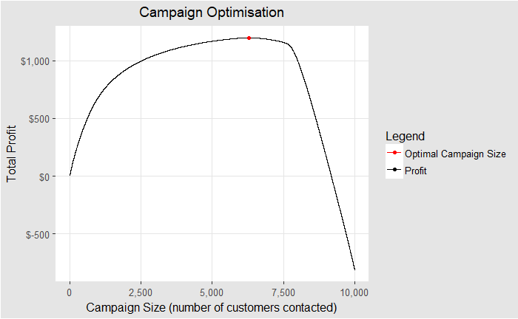
Campaign Optimisation

Slide 38
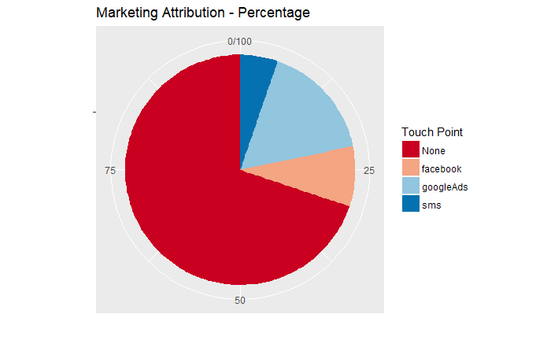

Marketing Attribution

Slide 39
End-To-End Demo

Slide 40
Download the End-to-End Demo in R
R Notebook Format
https://s3-ap-southeast-1.amazonaws.com/datarobotfiles/marketing+attribution+end+to+end+demo.Rmd
R HTML Format
https://s3-ap-southeast-1.amazonaws.com/datarobotfiles/marketing+attribution+end+to+end+demo.nb.html

Slide 41


Questions?
Colin Priest
colin@datarobot.com
Notes:
You can find a relevant icon in our icons kit.

